Slide 1
Internship 2022
Progress report format
for Flight Control team
Name: FAITH CHELANGAT

Slide 2
Tasks completed last week
[#25] … Testing the reaction wheel with current firmware
~Several tests were done on the reaction
Wheel
~Currently, our program works and the system responds as expected

Slide 3
~However, there were challenges experienced .
~There was imbalance of masses on the mounting case of our test bench which we are in the process of solving .

Slide 4
~As a result of imbalancing, our test was not as accurate as expected. Gravity caused continuous rotation and thus inability to have the mounting case settle at one specific point and consequently the motor still caused rotation of motor
~We hope to achieve almost perfect balance to ensure that we find more accurate results

Slide 5
PID TUNING RESULTS
~during the tests , we began on the pid tuning
For pid values of:
Kp=1
Ki=0
Kd=1
-We experienced overshoots. Solution: Reduce value of Kp to 0.5
~There was better response and overshoot reduced.

Slide 6
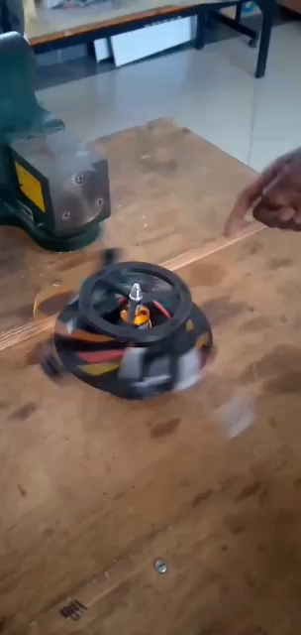

Slide 7
~Since during the earlier test we still had the imbalance we rectified the issue and retested with Kp value of 1.There was an improvement.
PID value of:
Kp=2
Kd=1
Ki=0

Slide 8
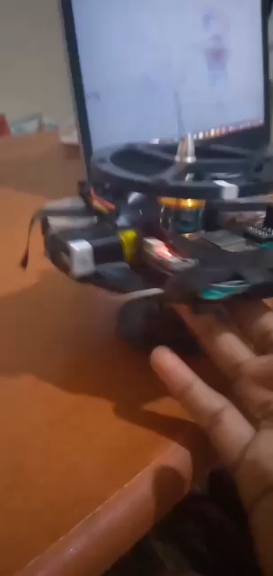
~Improved response time and less overshoots
-This is what currently we’re using.
~We will be doing more tests to improve perfomance

Slide 9
[#26] … Design of the mounting case
~Upon review of the previous design a couple of changes were made to the design of our mounting case
~We needed to cut a hole through the case to allow for cabling between the components on the mounting case to the flight computer
~The dimensions of the end to be fixed on the airframe were also altered

Slide 10
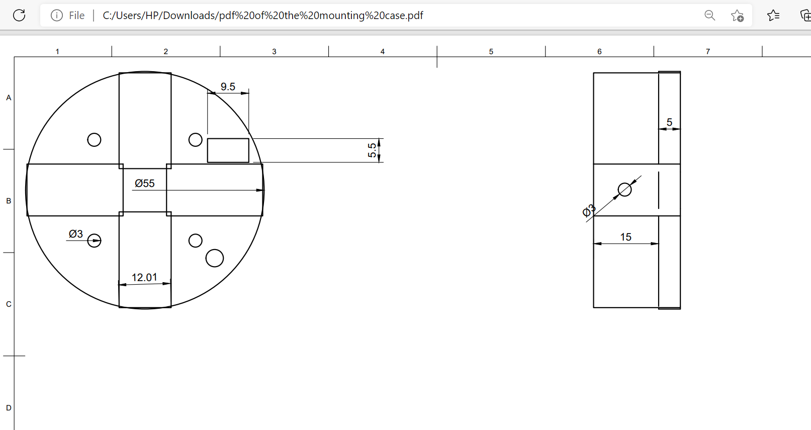
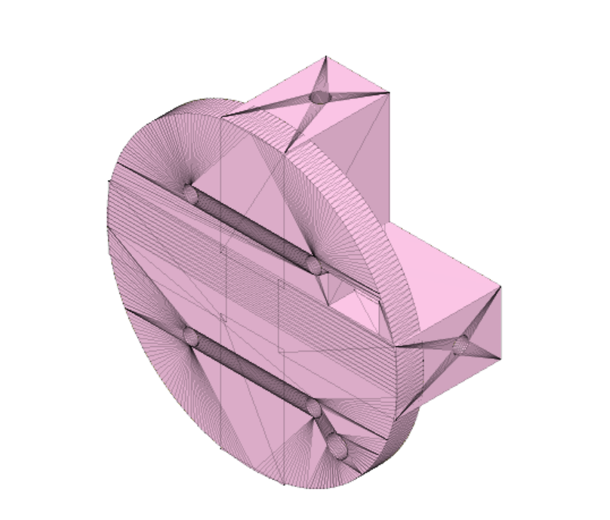

Slide 11
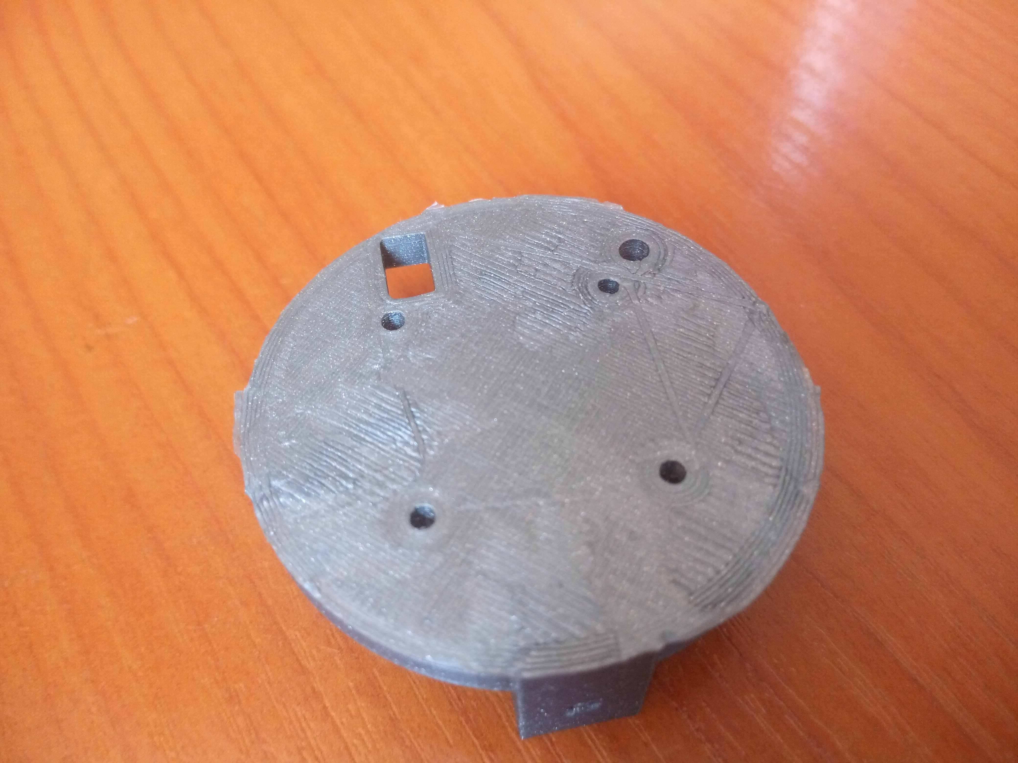
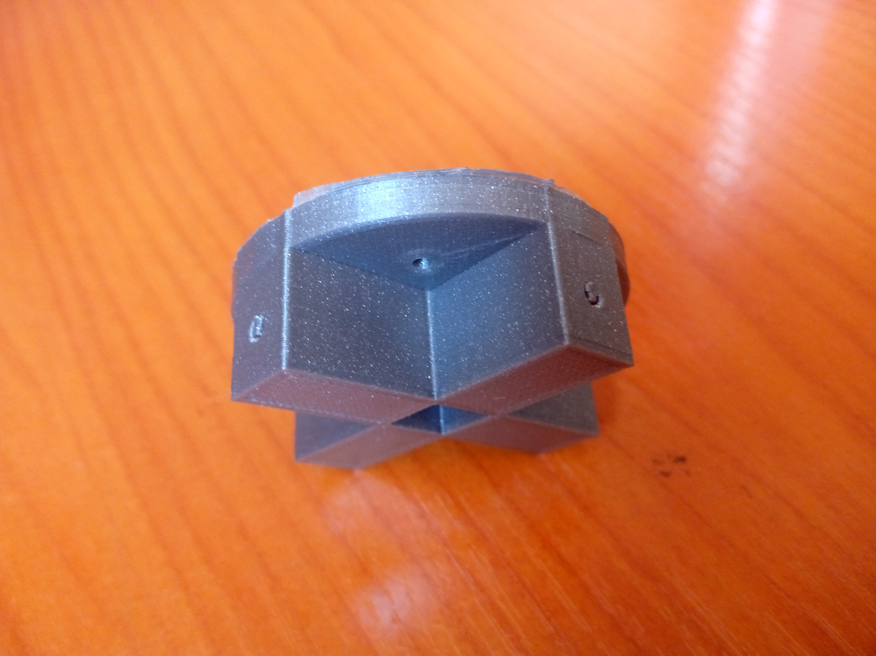
[#101] … Fabrication of the mounting case
~Due to changes in design,we 3D printed another mounting case.

Slide 12
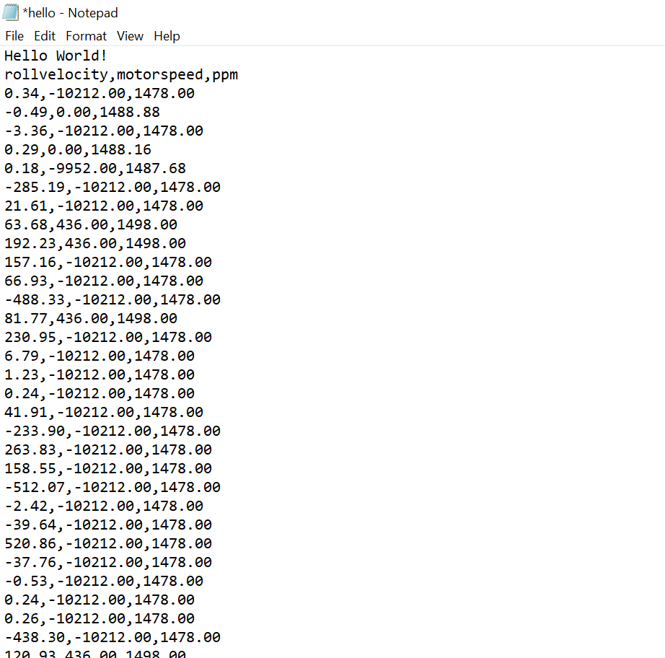
[#29] … Logging data
~During, our tests we logged data.
However , logging occurred only at neutral(motor was off)
~We’ll look into the issue

Slide 13
Tasks in this week
[#25] …Testing the reaction wheel
~This is a continuous process that will involve more of the PID tuning
~Other than detumbling, we hope to generate a bunch of input values on the motor and log how the plant reacts from the velocity of the mpu 6050. From a bunch of inputs and outputs we can work on generating the plant and generating an optimal PID controller

Slide 14
i
[#29] …Uploading logged data
~The data we logged initially were’nt comparable.
The speed of motor was in terms of ppm values while the
Roll velocity in rad/s
~Since mapping doesn’t work efficiently,we are using IR sensor to find the exact values of motorspeed before uploading for analysis

Slide 15
Timeline
Month | Intern week | Tasks
Jan
 | Week 1 | Familiarising with the N1/N2 project Research on the design of reaction wheel
 | Week 2 | Soldering of prototype flight control PCB
 | Week 3 | Design of the N2 reaction wheel
Feb | Week 4 | Testing of the reaction wheel Finalising on the Design of reaction wheel
 | Week 5 | Design of safety cage Design mounting case Avionics bay design
 | Week 6 | Improvement of Kalman Filter Data logging
 | Week 7

